Slide 1
WEEK 3
Lab meeting
Doan Manh Hung
Aug 28th, 2014

Slide 2
Homework
1. When b = 50mm, h = 100mm, L = 1m, E = 200GPa , Compare the result of deformation at the end of beam with Euler beam result and make a graph by increasing the number of element until the result is converged. (If there are commercial software that you can use, then also compare the result by using solid element.)
2. Repeat problem 1, when b = 50mm, h = 300mm, L = 1m.
3. Repeat problem 1, when b = 50mm, h = 5mm, L = 1m.

Slide 3
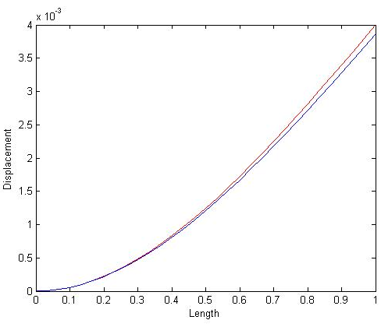
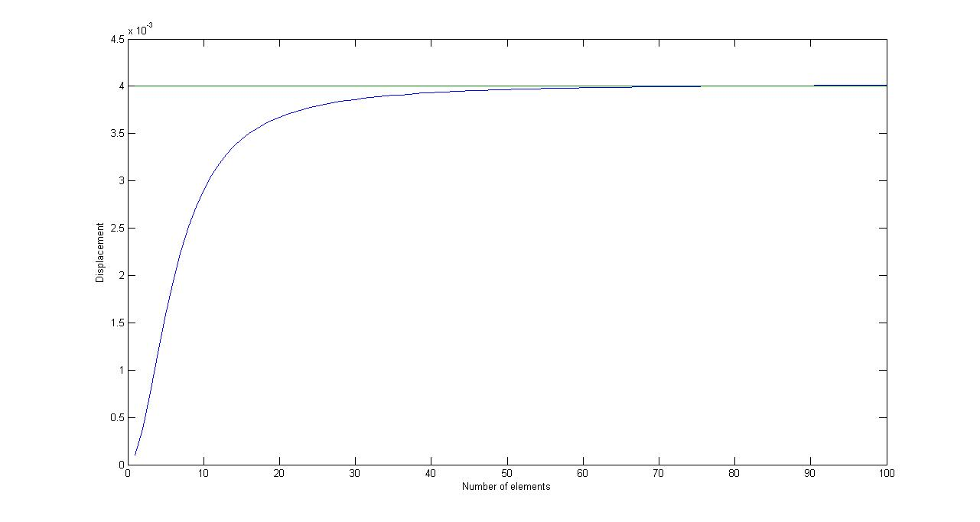
Homework
h=100mm
red for euler 0.0040mm
blue for timoshenko 0.0039mm

Slide 4
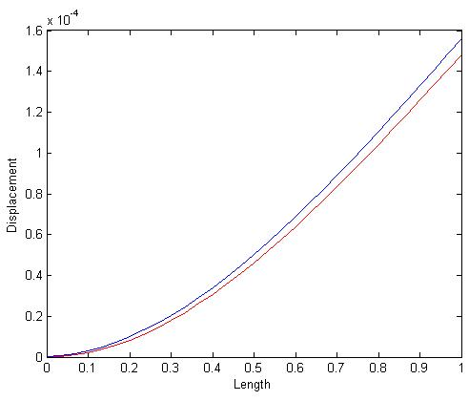
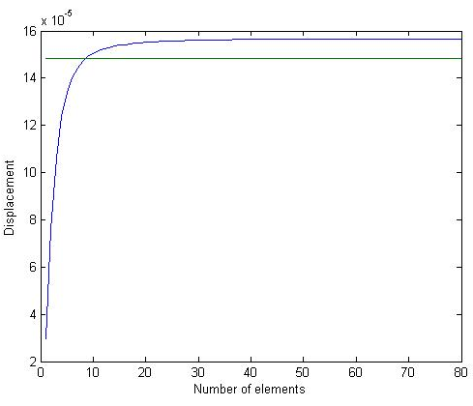
Homework
h=300
red for euler 1.4815e-004mm
blue for timoshenko 1.5607e-004mm

Slide 5
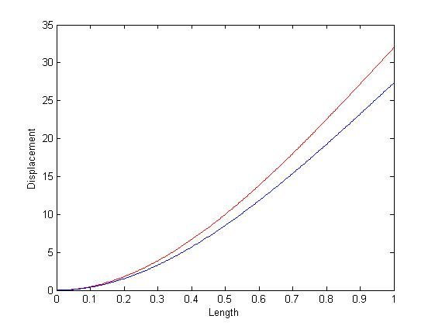
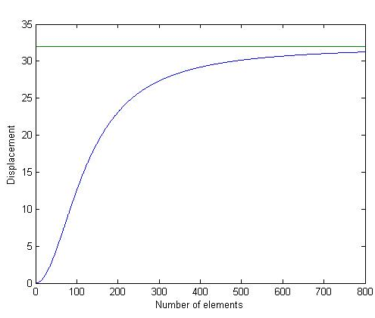
Homework
h=5mm
red for euler 32.0000mm
blue for timoshenko 27.3289mm

